Slide 1
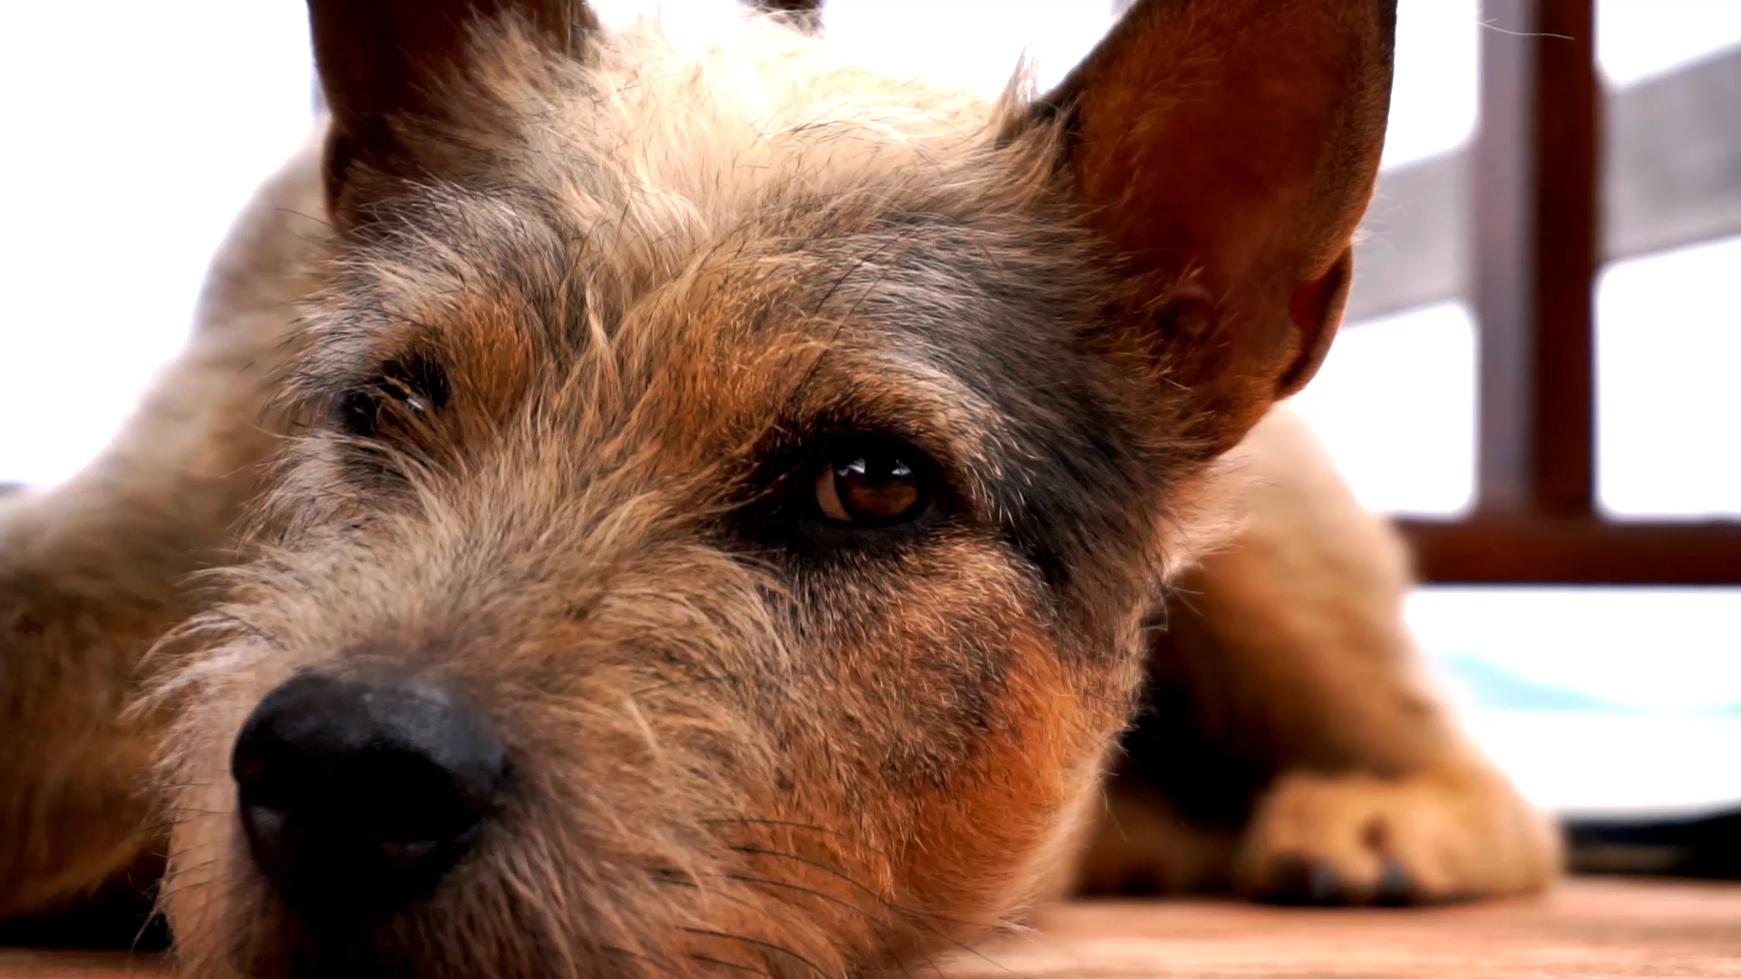
Using Data to Improve Animal Shelter Operations
Business Intelligence Term Project
Selena Cha
ISM6255

Slide 2
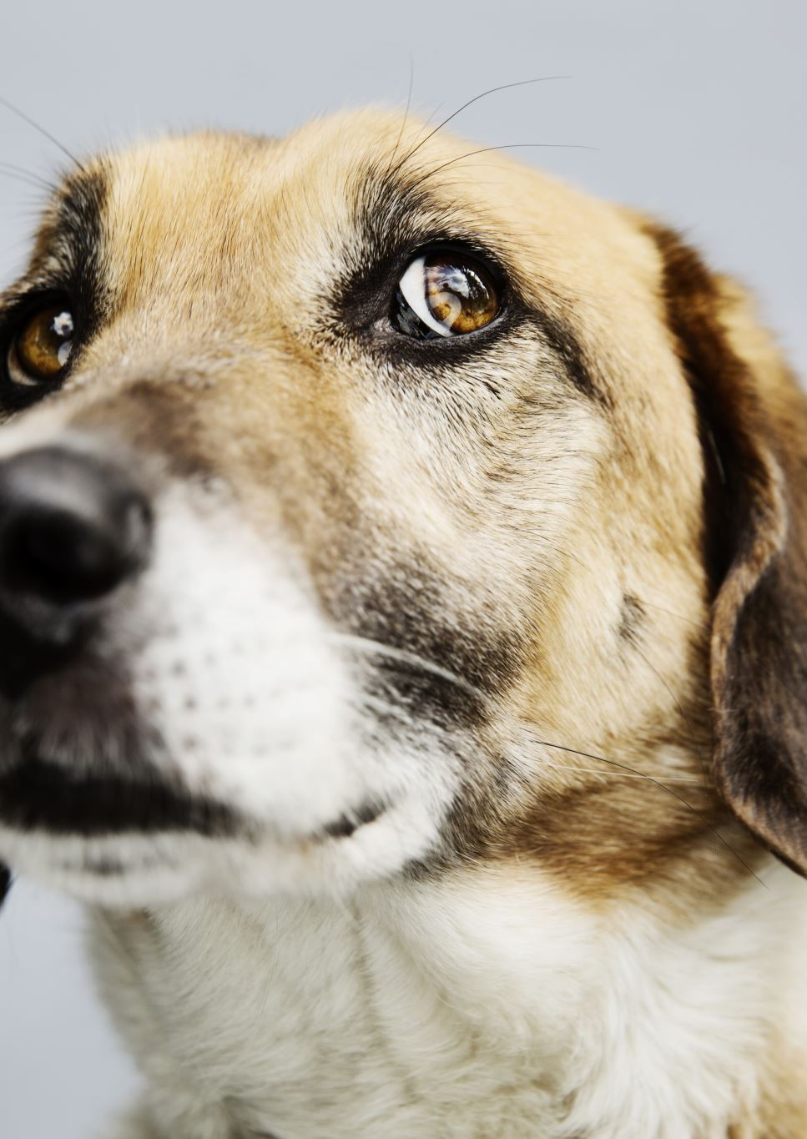
Challenge & Solution Why Business Intelligence Matters in Animal Welfare
Animal shelters collect a lot of information, from adoptions, fosters, veterinary visits, and volunteers. However, the data is often stuck in separate systems.
The goal of this project is to bring all the data together into one BI solution to help answer real questions:
Which dogs are getting adopted and when?
Where are our veterinary resources going?
How much time are volunteers contributing?

Slide 3
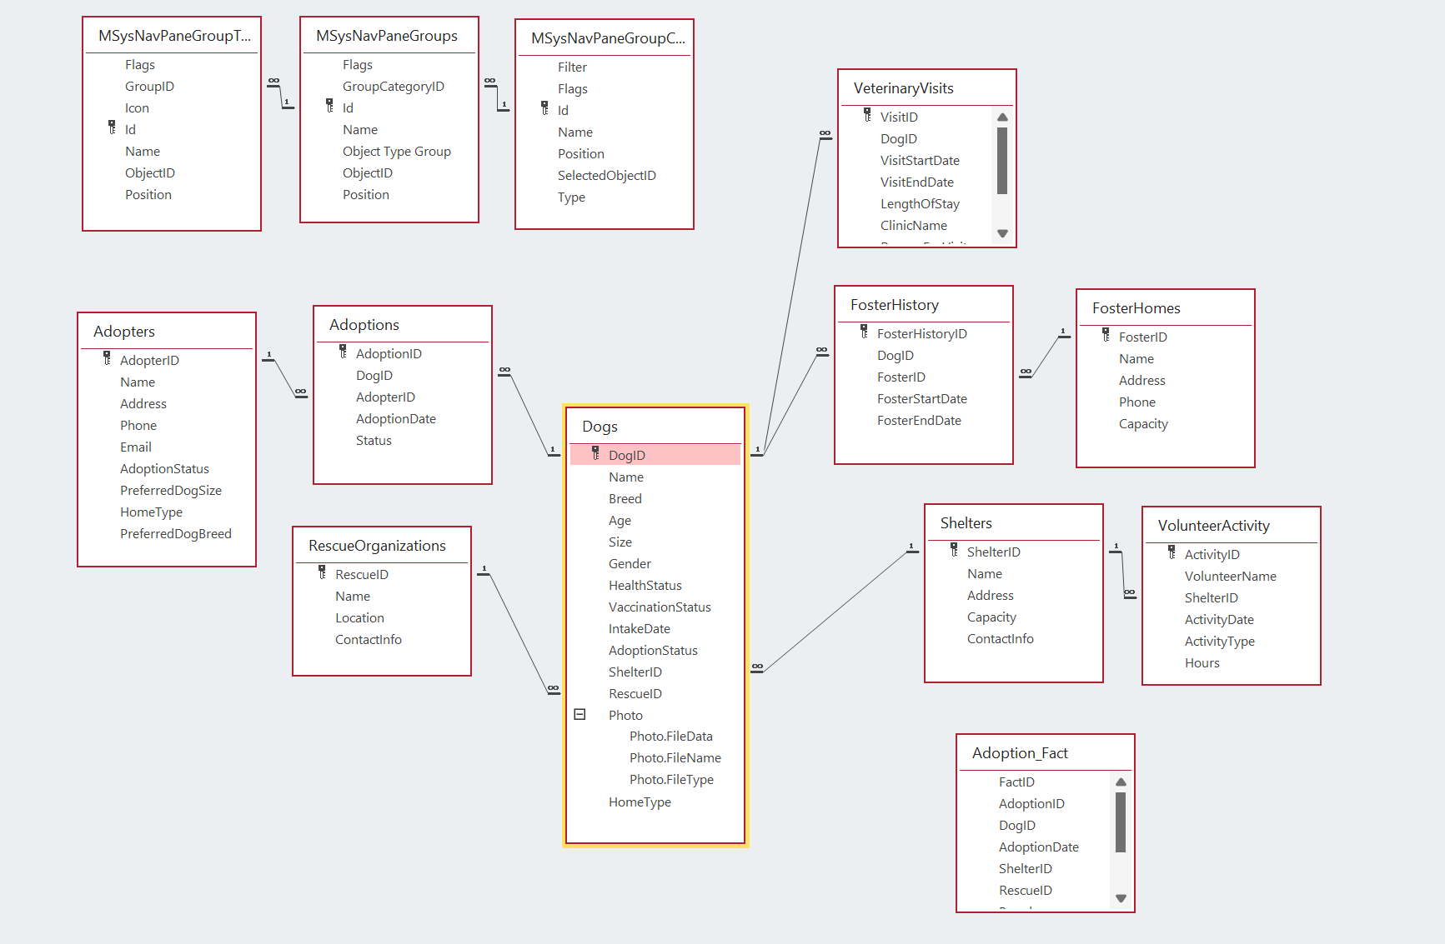
Starting Point Operational ERD – Relational Model for Daily Transactions
This project began with a normalized database that works well for storing records but isn’t optimized for analysis

Slide 4
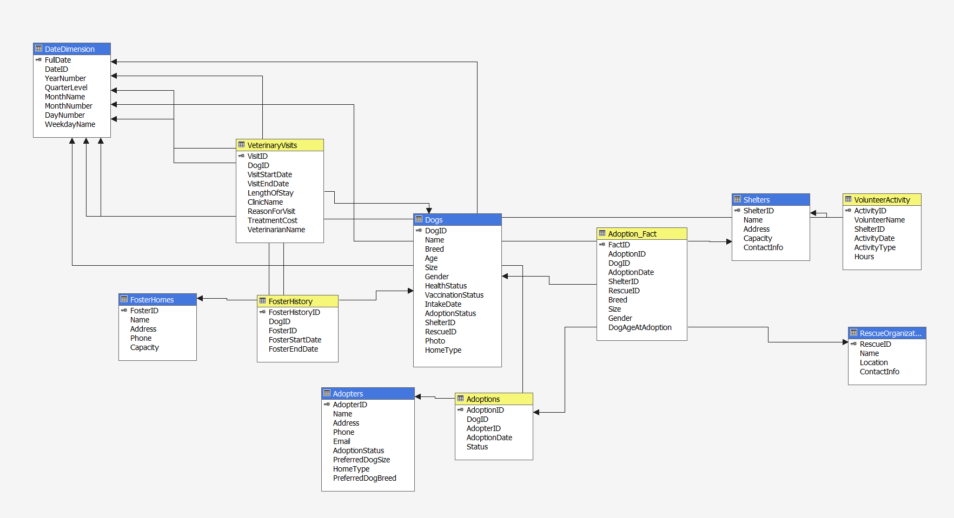
BI Transformation Star Schema for Decision Support
To enable fast, flexible analysis, this project redesigned the structure using a star schema
One fact table: Adoption_Fact
Multiple connected dimensions: Dogs, Adopters, DateDimension, VolunteerActivity, and more

Slide 6
Measurements Measures Created for Real-World Insight
Adoption Fact Count
How many dogs were adopted?
Total Treatment Cost
Vet care expenses
Avg Dog Age at Adoption
Adoption patterns by life stage
Foster History Count
How often were dogs placed in foster care?
Length of Stay
Time spent in care before adoption
Total Volunteer Hours
Community Involvement

Slide 7

Dimensions & Drilldowns Ask Better Questions – Support slicing and drilldowns
Dog Profile
Breed and Size
Date Dimension
Year, Quarter, Month, Day
Adopter
Home Type, Preferences
Volunteer Activity
Type, Hours
Veterinary Visits
Reason, Clinic, Cost

Slide 8
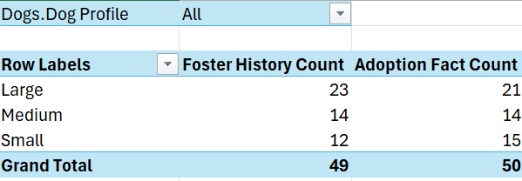
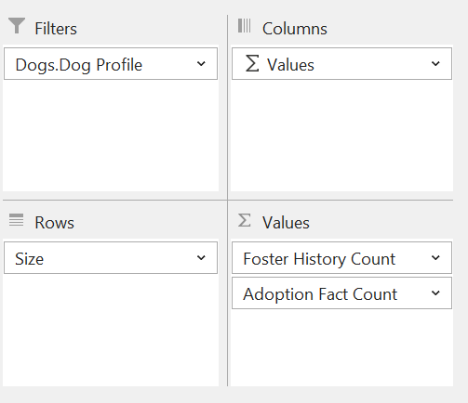
Adoption Patterns by Dog Size Which Dogs Get Adopted and Fostered Most?
Insight Learned
Large dogs were more frequently fostered, but small and medium dogs were adopted at nearly the same rate. These insights help shelters adjust housing needs and outreach efforts.

Slide 9
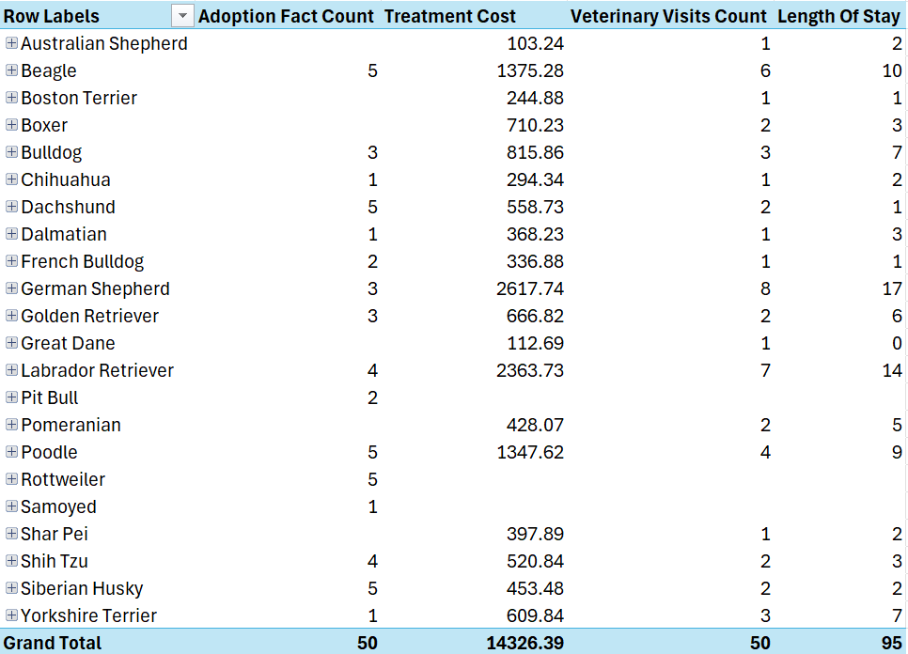
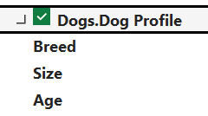
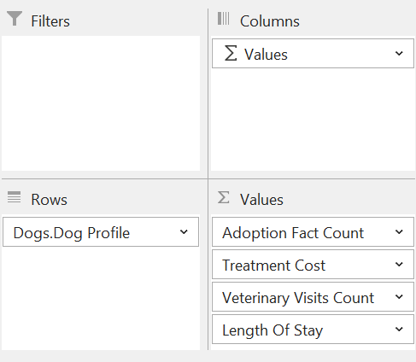
Cost and Care by Breed Vet Resources by Dog Breed
Insight Learned:
German Shepherds had the highest total treatment costs and longest stays, while breeds like Poodles and Beagles were adopted quickly but still required above-average care.

Slide 10
What I Learned (3Ws)
What Went Well
Deployed cube with clear measures
Built strong relationships in schema
Smooth Excel visualizations
What Didn’t Go Well
The initial cube failed due to localhost misconfig
Hierarchy warnings slowed progress
Some fields not defined as measures & dates and addresses not divided correctly
What I’d Do Differently
Break down Full Date into Year, Month, and Day to improve time-based filtering This has been fixed!
Structure addresses into Country, State, City, and Street to target locations more accurately. This has been fixed!
Explore ways to match dogs with ideal families faster by analyzing adopter preferences and dog traits
(Also add other types of animals)

Slide 11
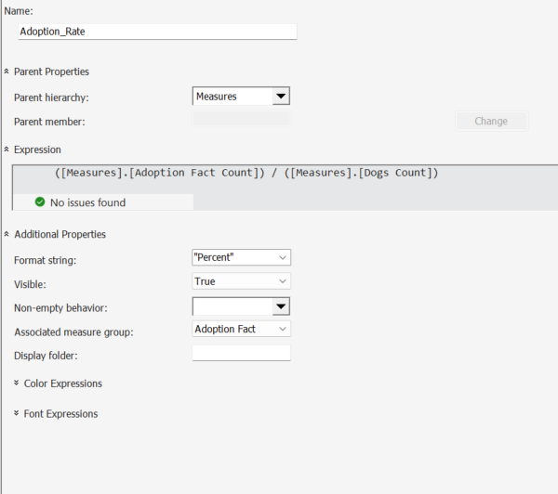
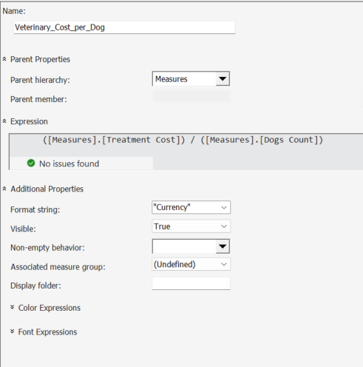
Added Calculations

Slide 12
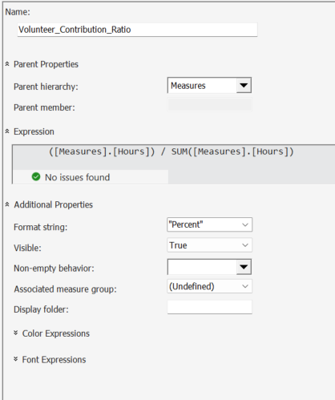
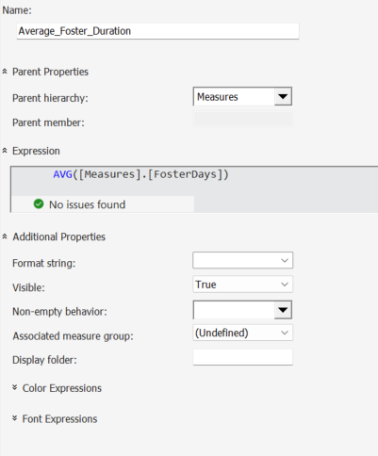
Added Calculations

Slide 13
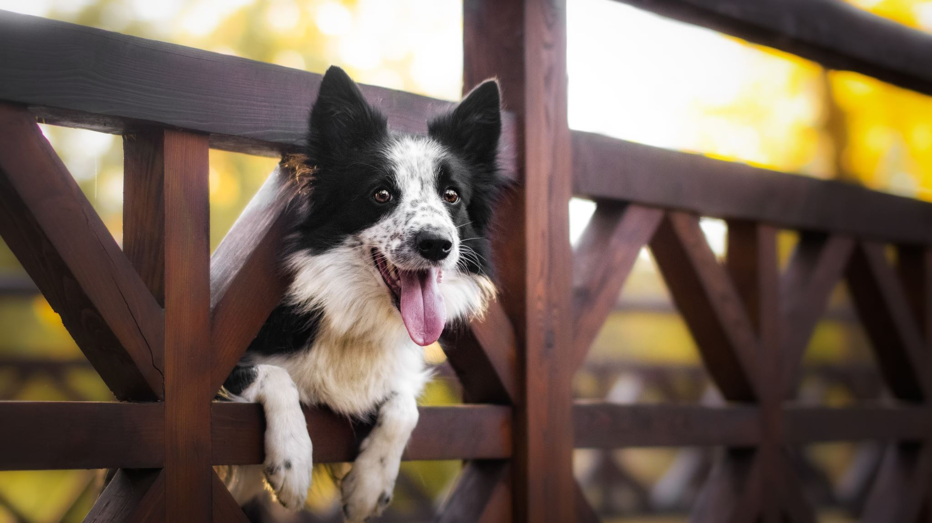
The Pivot Tables & Chart

Slide 14
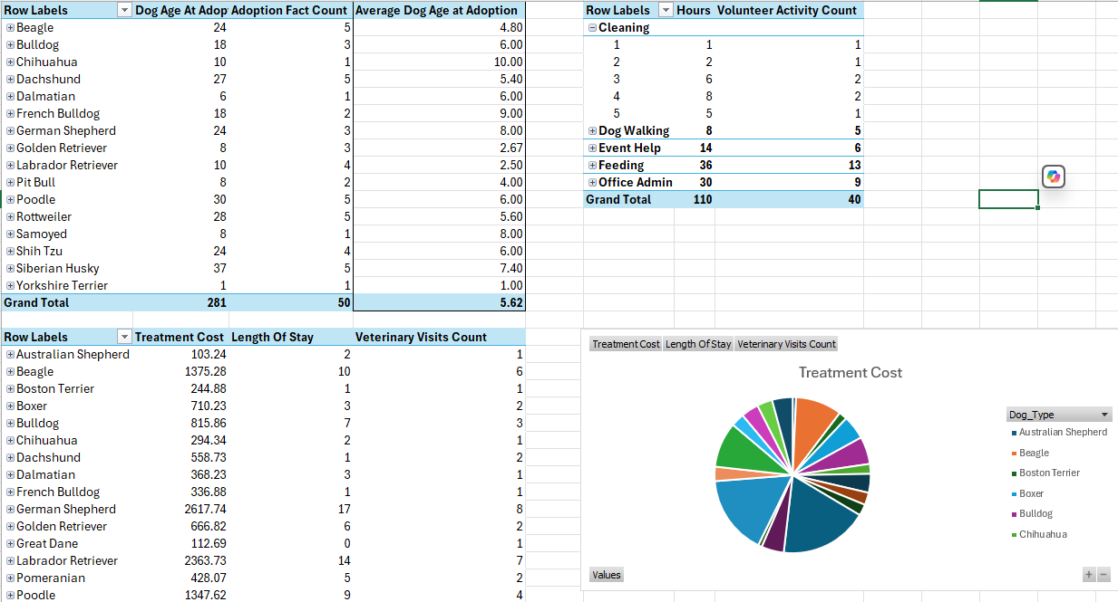

Slide 15
Thank You

